Slide 1
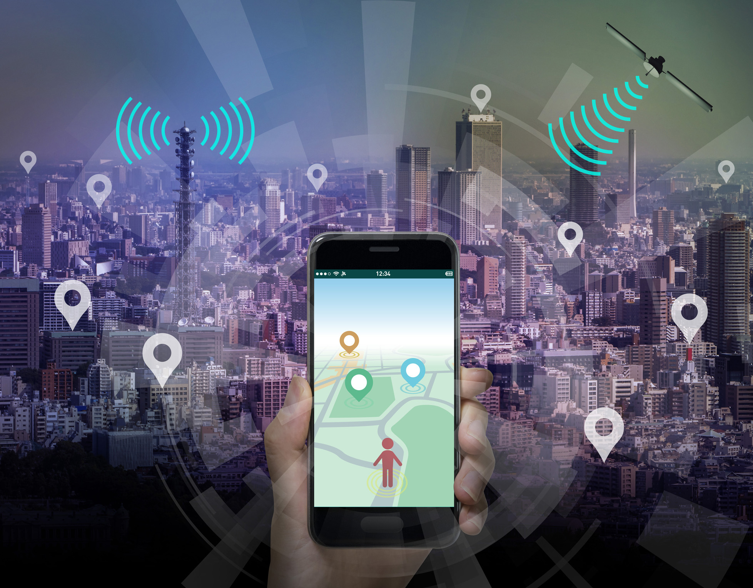
COLLEGE BUS GPS TRACKER
SUBJECT NAME : OBJECT ORIENTED SOFTWARE ENGINEERING
SUBJECT CODE : 231ITC402T
NAME | REGISTER NUMBER
ANDREA WINIFRED | 310623205010
HARIHARAN S | 310623205044
HARISH S | 310623205049
DEPARTMENT OF
INFORMATION TECHNOLOGY

Slide 2
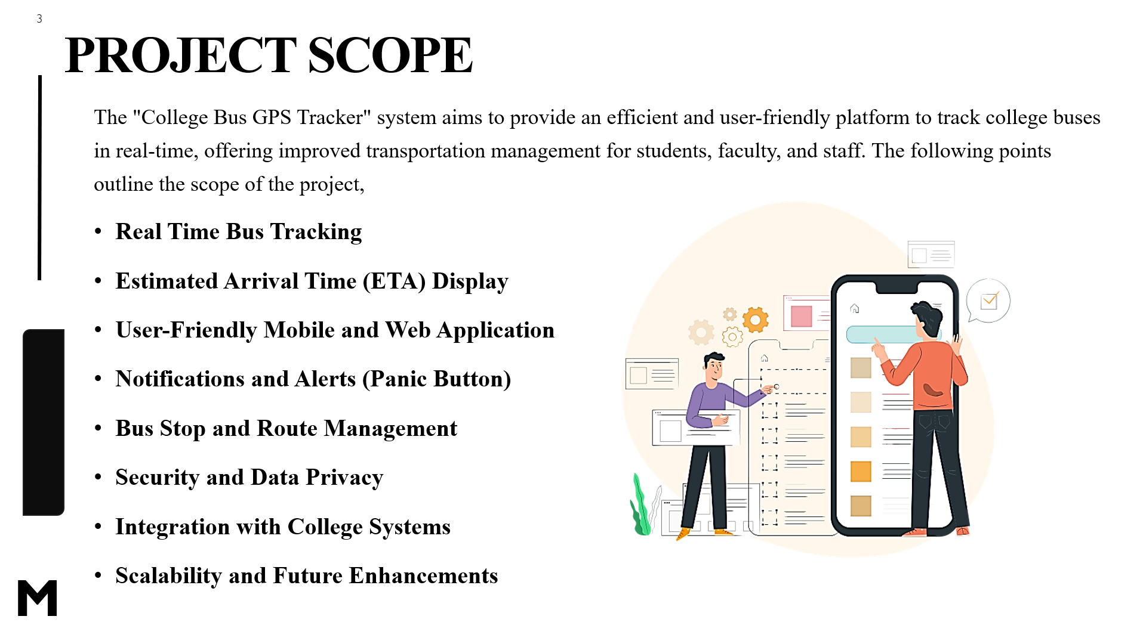

PROBLEM STATEMENT
In many colleges and universities, students and staff rely on the college bus system for daily transportation. However, a common issue faced by students is the lack of real-time tracking information about the buses, leading to uncertainty about arrival times, delays, and potential missed rides. The absence of an efficient tracking system can cause frustration, anxiety, and sometimes lead to students missing important classes or activities.
There is a need for a reliable and user-friendly system that provides real-time tracking of the college buses, allowing students and staff to monitor the bus locations, estimated arrival times, and any potential delays. This would enhance the overall commuting experience, improve time management, and ensure smoother coordination between students and the bus service.

Slide 3
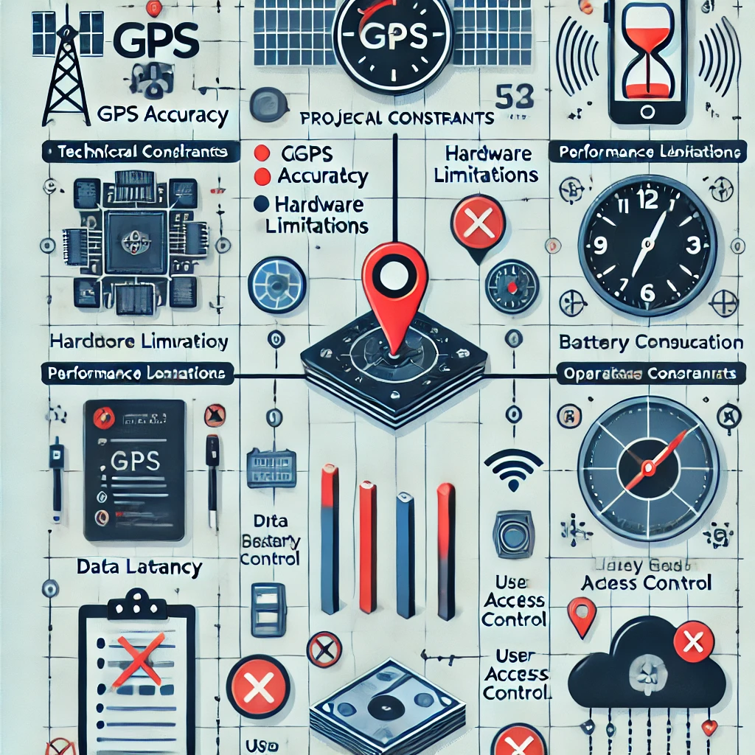


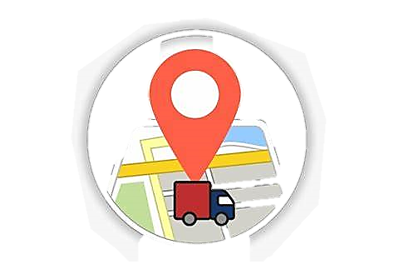


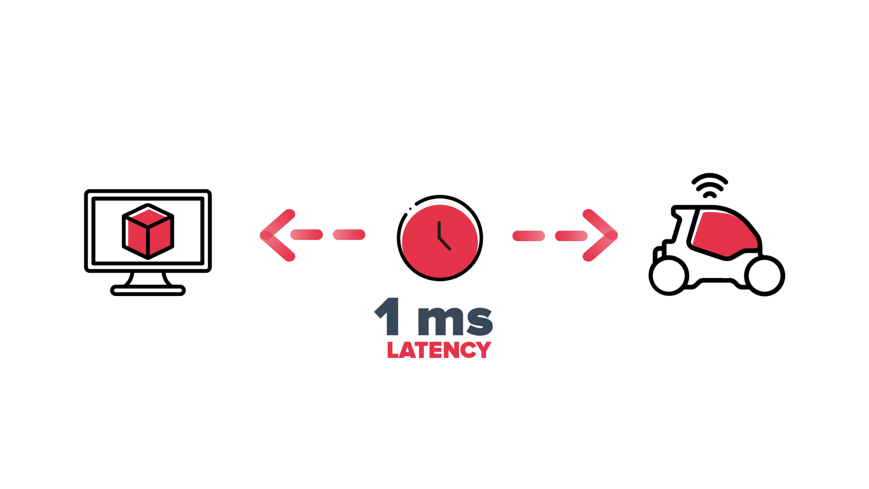
CONSTRAINTS
TECHNICAL CONSTRAINTS
Real-Time Accuracy
Hardware Limitations
Battery & Power Consumption
PERFORMANCE CONSTRAINTS
Latency
Scalability
Data Storage
SECURITY CONSTRAINTS
Data Privacy
Role-Based Access Control
OPERATIONAL CONSTRAINTS
Internet Dependency
Device Compatibility
Cost Constraints

Slide 4
TOOL REQUIREMENTS

